Slide 1
Module 1 – introduction to 8086 instruction set

Slide 2
Instruction set
Instruction set of 8086
Data copy/transfer instructions
Arithmetic and logical instructions
Branch instructions
Loop Instructions
Machine control Instructions
Flag manipulation instructions
Shift and Rotate instructions
String Instructions

Slide 3
Data copy/transfer instructions
PUSH - Push to stack – pushes the contents of the register or memory location to the stack. Ex., PUSH AX
POP - Pop from Stack – loads value from stack to the register Ex., POP AX
XCHG – Exchange – Exchanges the contents of the specified source and destination registers or memory locations. Ex., XCHG BX, AX
IN – Input the port – To read an input port. Ex., IN AL, 03H
OUT – Output to the port – Write to the output port. Ex., OUT DX, AX

Slide 4
Continued
XLAT – Translate – TO find out the codes when there is code conversion problem using lookup table technique.
LEA – Load effective address – Loads the effective address formed by the destination operand into the specified source register. Ex., LEA BX, ADR
LDS/LES – Load pointer to DS/ES – Loads DS or ES register in the instruction with the current memory location specified as source in the instruction.
LAHF – Load AH from lower byte of flag – loads the AH register with the lower byte of the flag register

Slide 5
Continued
SAHF – Store AH to lower byte of flag register – Sets or resets the condition code flags (except overflow) in the lower byte of the flag register depending upon the corresponding bit positions in AH
PUSHF – Push flags to stack – Pushes the flag register on to the stack, first upper byte and then lower byte
POPF – Pop flags from stack – loads the flag register completely from the word content of the memory location currently addressed by SP and SS.

Slide 6
Arithmetic instructions
ADD – Add – Adds data or content of the memory location specified in the instruction or register to the contents of another register or memory location. Ex., ADD AX, BX
ADC – Add with carry – Same as add but adds the carry flag bit to the result. Ex., ADC AX, BX
INC - Increment – Increases the content of the specified register or memory location by 1. Ex., INC AX
DEC – Subtracts 1 from the specified register or memory location. Ex., DEC AX

Slide 7
Continued
SUB – Subtract – Subtracts the source operand from the destination operand and result is stored in the destination operand. Ex., SUB AX, BX
SBB – Subtract with borrow – Subtracts the source operand and the borrow flag (CF) which may reflect the result of the previous calculations, from the destination operand. Ex., SBB AX, BX
CMP – Compares the source operand with a destination operand. It subtracts the source operand from the destination operand but does not store the result. Ex., CMP BX, CX
AAA – Executed after ADD instruction. Adds two ASCII coded operands to give a byte of result in AL.

Slide 8
Continued
AAS – ASCII Adjust AL After subtraction – Corrects the result in AL register after subtracting two unpacked ASCII operands.
AAM – ASCII Adjust after multiplication – When executed, converts the product available in AL into unpacked BCD format.
AAD – ASCII Adjust before division – Converts two unpacked BCD digits in AH and AL to the equivalent binary number in AL.
DAA – Decimal Adjust Accumulator – Convert the result of addition of two packed BCD numbers to a valid BCD number.
DAS – Decimal Adjust for Subtraction – The result of subtraction of two packed BCD numbers to a valid BCD number

Slide 9
Continued
NEG – Negate – Forms 2’s complement of the specified destination.
MUL – Unsigned multiplication byte or word – Multiplies unsigned byte or word by the contents of AL. Ex., MUL BX.
IMUL – Signed Multiplication – Signed byte in source operand by a signed byte in AL. Ex., IMUL BX.
CBW – Convert signed byte to word – Converts signed byte to a signed word. Result will be in AX
CWD – Convert signed word to double word – Copies the sign bit of AX to all the bits of the DX register

Slide 10
Continued
DIV – Unsigned Division – Performs unsigned division.
IDIV – Signed Division.

Slide 11
LOGICAL instruction
AND – Logical AND – Bit by bit ANDs the source operand to the destination operand. Ex., AND AX, BX
OR – Logical OR – Carries out OR operation. Ex., OR AX, BX
NOT – Logical Invert – Complements the content of an operand register or memory location, bit by bit. Ex., NOT AX
XOR – Logical XOR – Gives high output when two input bits are the same. Ex., XOR AX, BX

Slide 12
Continued
TEST – Logical compare instruction – Performs bit by bit logical AND operation on the two operands. TEST AX, BX
SHL/SAL – Shift Logical/Arithmetic Left – shift the operand word or byte bit by bit to the left and insert zero in the newly introduced least significant bits.
SHR – Shift Logical Right – Performs bit wise right shifts on the operand word or byte.
SAR – Shift Arithmetic right – Performs right shifts on the operand word or byte
ROR – Rotate right without carry – Rotates the contents of the destination operand to the right either by 1 or by the specified count, excluding carry.

Slide 13
Continued
ROL – Rotate Left without Carry – Rotates the contents of the destination operand to the left by the specified count, bit by bit, excluding carry.
RCR – Rotate right through carry - Rotates the contents of the destination operands to the right, bit by bit, by specified count. Carry flag is pushed into the MSB of the operand.
RCL – Rotate Left through carry – rotates the contents of the destination operand left by the specified count through carry flag.

Slide 14
String manipulation instructions
Data bytes available in memory at consecutive locations, to be referred to collectively or individually called as called byte strings or word strings
REP – Repeat Instruction Prefix – Used as a prefix to other instruction
MOVSB/MOVSW – Move Strings Byte or String Word – Moving a string of bytes from one location to the other.
CMPS – Compare string byte or string word – Compare two strings of byte or words.

Slide 15
Continued
SCAS – Scan String Byte or String Word – Scans a string of bytes or words for an operand byte or word specified in the register.
LODS – Load string byte or string word – Loads the AL/AX register
STOS – Stores the contents of AL/AX register to a location in the string given by ES:DI register pair.

Slide 16
Control transfer or branching instructions
Transfers the flow of execution of the program to a new address specified in the instruction directly or indirectly. CS and PI get loaded with new values which refer to the location where the flow of instruction is going to be transferred.
Unconditional Control Transfer Instructions – Execution control is transferred to the specified location dependent of any status or condition
Conditional Control Transfer Instructions – control is transferred to the specified location, provided, the result of previous operation satisfies a particular condition. Otherwise, the normal flow is followed

Slide 17
Unconditional branch instructions
CALL – Unconditional Call – To call a subroutine from the main program.
Address can be specified directly or indirectly depending upon the addressing mode.
Eon execution the CS and IP are loaded with the segment and offset addresses of the procedure to be called.
NEAR CALL – Intrasegment addressing mode – pushes only the IP register
FAR CALL – Intersegment addressing mode – pushes both CS and IP registers

Slide 18
Continued
RET – Return form the procedure – After CALL instruction RET must be called so that the stored contents of CS and IP along with the flags are returned to the CS, IP and Flag registers from the stack and the execution of the main program continues further.
Near – Current content of the stack pointer points only to IP
Far – Current content of the stack pointer points to CS and IP.

Slide 19
Continued
INT N – Interrupt Type N – There are 256 interrupts given by 00H to FFH.
When INT N is executed, the Type byte N is multiplied by 4 and the contents of IP.
Ex., INT 10H → 10x4 = 40H
Hence the pointer to IP and CS = 0000:0040H
IP Low – 0000:0040
IP High - 0000:0041
CS Low - 0000:0042
CS High - 0000:0043

Slide 20
Continued
INTO – Interrupt on Overflow – Executed when the overflow flag OF is set high.
JMP – Unconditional Jump – Unconditionally transfers the control of execution to the specified address using 8 bit or 16 bit displacement or CS:IP
Ex., JMP DISP 8-bit – Intrasegment relative short
Ex., JMP IP:CS
IRET – Return from ISR – When ISR is called, before transferring control to it, the IP, CS and Flag registers are loaded to the stack. At the end of ISR, IRET is executed and the values from the registers are retrieved from stack and the main program continues

Slide 21
Continued
LOOP – Loop unconditionally – Executes the part of the program from the label or address specified upto the loop instruction, CX number of times. CX is automatically decremented.
Ex., MOV CX, 0010
----
Label: ----
----
----
Loop Label

Slide 22
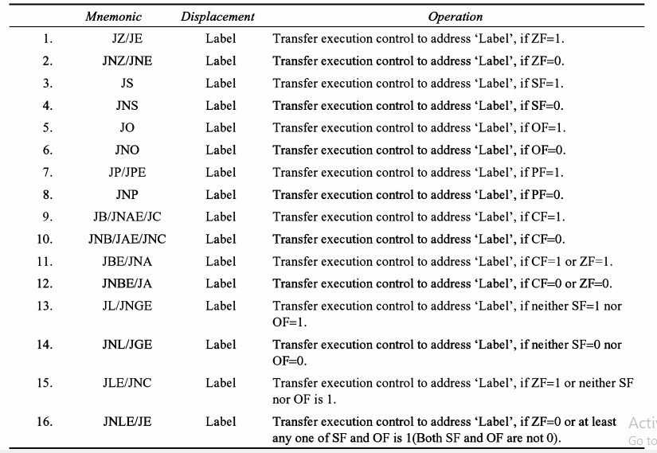
Conditional branch instruction

Slide 23
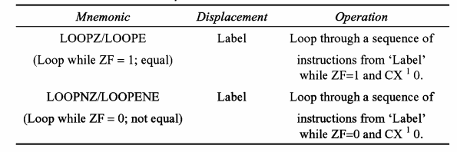
Conditional loop instruction

Slide 24
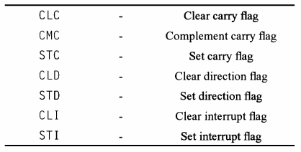
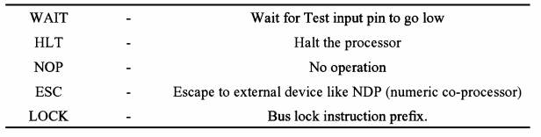
Flag manipulation and process control instructions
Machine control instructions

Slide 25
WebLINKs
https://www.youtube.com/watch?v=EfwZ_TgfM_g
https://www.youtube.com/watch?v=vu6eLFmrwaA

